Slide 1
Guided and Unguided Medium

Slide 2
Transmission media are actually located below the physical layer and are directly controlled by the physical layer.
Transmission medium can be broadly defined as anything that can carry information from a source to a destination.
In telecommunications, transmission media can be divided into two broad categories: guided and unguided.
Guided media include twisted-pair cable, coaxial cable, and fiber-optic cable. Unguided medium is free space

Slide 3
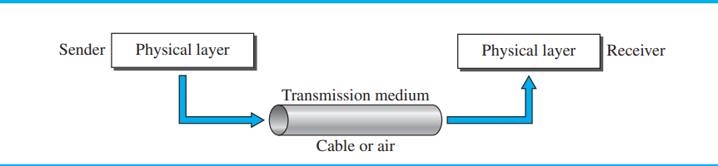

Slide 4
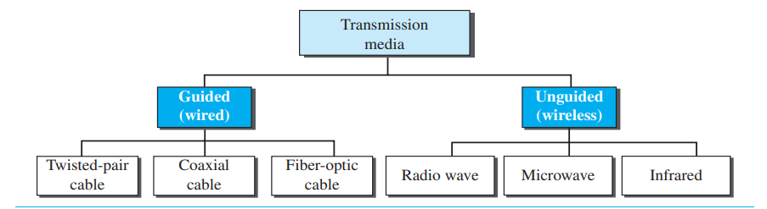

Slide 5
GUIDED MEDIA
Guided media, which are those that provide a conduit from one device to another, include twisted-pair cable, coaxial cable, and fiber-optic cable.
A signal traveling along any of these media is directed and contained by the physical limits of the medium.
Twisted-pair and coaxial cable use metallic (copper) conductors that accept and transport signals in the form of electric current.
Optical fiber is a cable that accepts and transports signals in the form of light.

Slide 6
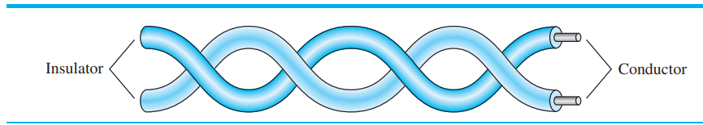
Twisted-Pair Cable
A twisted pair consists of two conductors (normally copper), each with its own plastic insulation, twisted together

Slide 7
One of the wires is used to carry signals to the receiver, and the other is used only as a ground reference.
The receiver uses the difference between the two. In addition to the signal sent by the sender on one of the wires, interference (noise) and crosstalk may affect both wires and create unwanted signals.
If the two wires are parallel, the effect of these unwanted signals is not the same in both wires because they are at different locations relative to the noise or crosstalk sources (e.g., one is closer and the other is farther).
By twisting the pairs, a balance is maintained.
For example, suppose in one twist, one wire is closer to the noise source and the other is farther; in the next twist, the reverse is true
Twisting makes it probable that both wires are equally affected by external influences (noise or crosstalk).
This means that the receiver, which calculates the difference between the two, receives no unwanted signals.
The unwanted signals are mostly canceled out. The number of twists per unit of length has some effect on the quality of the cable.

Slide 8
Unshielded Versus Shielded Twisted-Pair Cable
The most common twisted-pair cable used in communications is referred to as unshielded twisted-pair (UTP).
IBM has also produced a version of twisted-pair cable for its use, called shielded twisted-pair (STP).
STP cable has a metal foil or braided mesh covering that encases each pair of insulated conductors.
Although metal casing improves the quality of cable by preventing the penetration of noise or crosstalk, it is bulkier and more expensive.

Slide 9
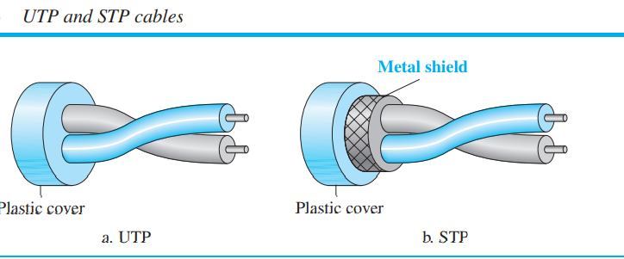

Slide 10
Categories
The Electronic Industries Association (EIA) has developed standards to classify unshielded twisted-pair cable into seven categories.
Categories are determined by cable quality, with 1 as the lowest and 7 as the highest.
Each EIA category is suitable for specific uses.

Slide 11
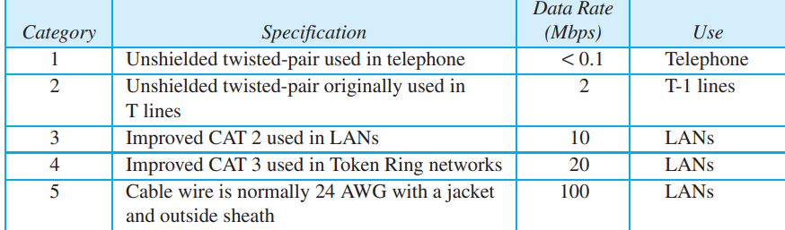

Slide 12
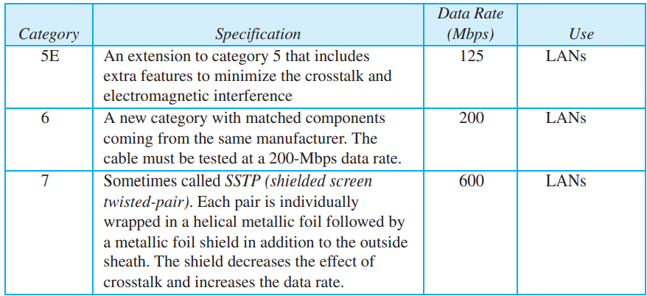

Slide 13
The most common UTP connector is RJ45 (RJ stands for registered jack), as shown in Figure
The RJ45 is a keyed connector, meaning the connector can be inserted in only one way.

Slide 14
One way to measure the performance of twisted-pair cable is to compare attenuation versus frequency and distance.
A twisted-pair cable can pass a wide range of frequencies.
However, with increasing frequency, the attenuation, measured in decibels per kilometer (dB/km), sharply increases with frequencies above 100 kHz. Note that gauge is a measure of the thickness of the wire.
Applications
Twisted-pair cables are used in telephone lines to provide voice and data channels.
The local loop—the line that connects subscribers to the central telephone office— commonly consists of unshielded twisted-pair cables.

Slide 15
Coaxial Cable
Coaxial cable (or coax) carries signals of higher frequency ranges than those in twistedpair cable, in part because the two media are constructed quite differently.
Instead of having two wires, coax has a central core conductor of solid or stranded wire (usually copper) enclosed in an insulating sheath, which is, in turn, encased in an outer conductor of metal foil, braid, or a combination of the two.
The outer metallic wrapping serves both as a shield against noise and as the second conductor, which completes the circuit.
This outer conductor is also enclosed in an insulating sheath, and the whole cable is protected by a plastic cover

Slide 16
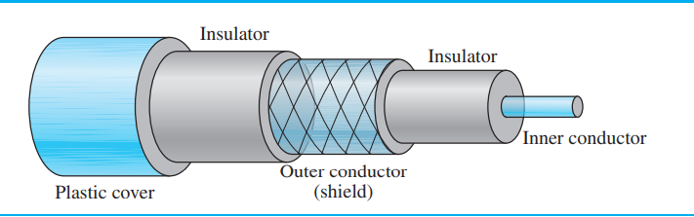

Slide 17
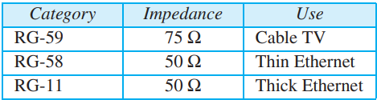
Coaxial Cable
Standards Coaxial cables are categorized by their Radio Government (RG) ratings. Each RG number denotes a unique set of physical specifications, including the wire gauge of the inner conductor, the thickness and type of the inner insulator, the construction of the shield, and the size and type of the outer casing. Each cable defined by an RG rating is adapted for a specialized function.

Slide 18
Coaxial Cable Connectors To connect coaxial cable to devices, we need coaxial connectors.
The most common type of connector used today is the Bayonet Neill-Concelman (BNC) connector.
Figure shows three popular types of these connectors: the BNC connector, the BNC T connector, and the BNC terminator

Slide 19
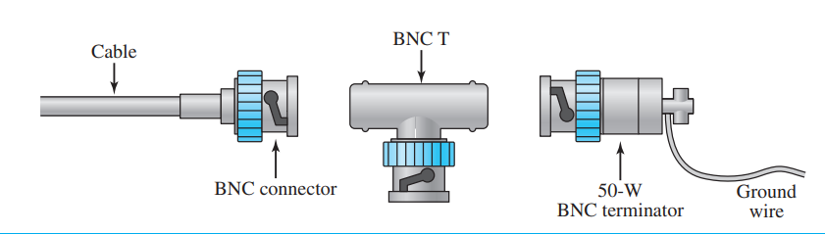

Slide 20
Performance
The attenuation is much higher in coaxial cable than in twisted-pair cable. In other words, although coaxial cable has a much higher bandwidth, the signal weakens rapidly and requires the frequent use of repeaters.
Applications
Coaxial cable was widely used in analog telephone networks where a single coaxial network could carry 10,000 voice signals.
Later it was used in digital telephone networks where a single coaxial cable could carry digital data up to 600 Mbps.
However, coaxial cable in telephone networks has largely been replaced today with fiberoptic cable.

Slide 21
Fiber-optic cable
A fiber-optic cable is made of glass or plastic and transmits signals in the form of light.
Optical fibers use reflection to guide light through a channel.
A glass or plastic core is surrounded by a cladding of less dense glass or plastic.
The difference in density of the two materials must be such that a beam of light moving through the core is reflected off the cladding instead of being refracted into it.

Slide 22
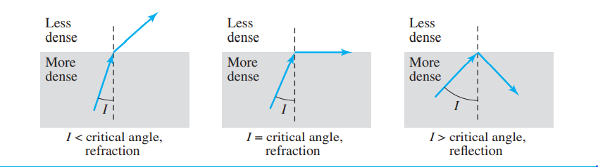

Slide 23
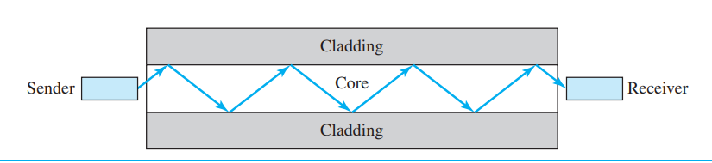
Core: The optical fibre consists of a narrow strand of glass or plastic known as a core. A core is a light transmission area of the fibre. The more the area of the core, the more light will be transmitted into the fibre.
Cladding: The concentric layer of glass is known as cladding. The main functionality of the cladding is to provide the lower refractive index at the core interface as to cause the reflection within the core so that the light waves are transmitted through the fibre.
Jacket: The protective coating consisting of plastic is known as a jacket. The main purpose of a jacket is to preserve the fibre strength, absorb shock and extra fibre protection.

Slide 24
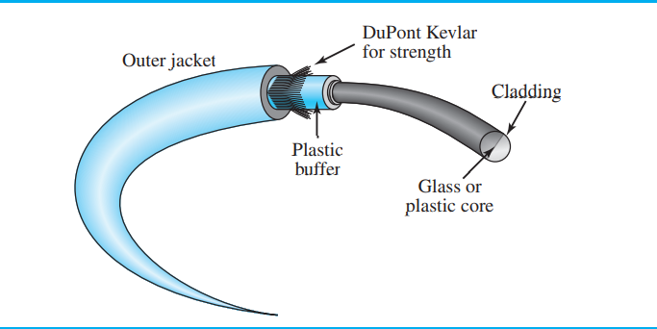
Cable Composition
The outer jacket is made of either PVC or Teflon.
Inside the jacket are Kevlar strands to strengthen the cable.
Kevlar is a strong material used in the fabrication of bulletproof vests. Below the Kevlar is another plastic coating to cushion the fiber.
The fiber is at the center of the cable, and it consists of cladding and core.

Slide 25
Propagation Modes
Current technology supports two modes (multimode and single mode) for propagating light along optical channels, each requiring fiber with different physical characteristics.
Multimode can be implemented in two forms: step-index or graded-index
Multimode :Multimode is so named because multiple beams from a light source move through the core in different paths

Slide 26
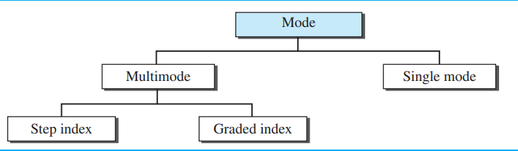

Slide 27
In multimode step-index fiber, the density of the core remains constant from the center to the edges.
A beam of light moves through this constant density in a straight line until it reaches the interface of the core and the cladding.
At the interface, there is an abrupt change due to a lower density; this alters the angle of the beam’s motion.
The term step-index refers to the suddenness of this change, which contributes to the distortion of the signal as it passes through the fiber.
A second type of fiber, called multimode graded-index fiber, decreases this distortion of the signal through the cable.
The word index here refers to the index of refraction.
The index of refraction is related to density.
A graded-index fiber, therefore, is one with varying densities. Density is highest at the center of the core and decreases gradually to its lowest at the edge.

Slide 28
The single-mode fiber itself is manufactured with a much smaller diameter than that of multimode fiber, and with substantially lower density (index of refraction).
The decrease in density results in a critical angle that is close enough to 90° to make the propagation of beams almost horizontal.
In this case, the propagation of different beams is almost identical, and delays are negligible.
All the beams arrive at the destination “together” and can be recombined with little distortion to the signal

Slide 29
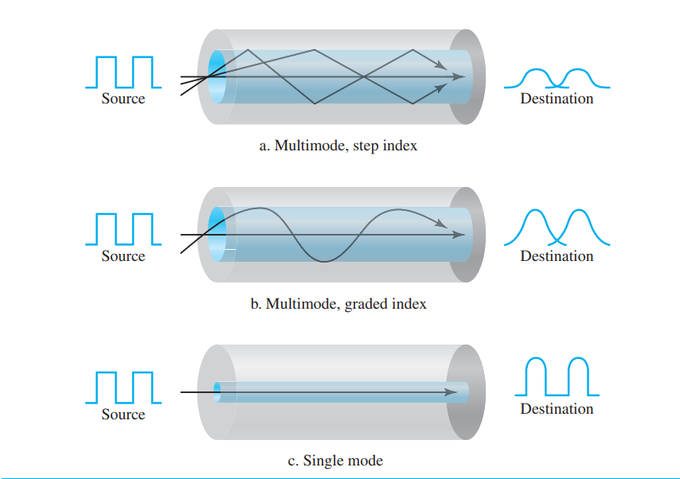

Slide 30
Applications
Fiber-optic cable is often found in backbone networks because its wide bandwidth is cost-effective.
Today, with wavelength-division multiplexing (WDM), we can transfer data at a rate of 1600 Gbps.
Some cable TV companies use a combination of optical fiber and coaxial cable, thus creating a hybrid network.
Optical fiber provides the backbone structure while coaxial cable provides the connection to the user premises.
This is a cost-effective configuration since the narrow bandwidth requirement at the user end does not justify the use of optical fiber.
Local-area networks such as 100Base-FX network (Fast Ethernet) and 1000Base-X also use fiber-optic cable.

Slide 31
Advantages
Fiber-optic cable has several advantages over metallic cable (twisted-pair or coaxial).
❑ Higher bandwidth. Fiber-optic cable can support dramatically higher bandwidths (and hence data rates) than either twisted-pair or coaxial cable. Currently, data rates and bandwidth utilization over fiber-optic cable are limited not by the medium but by the signal generation and reception technology available.
❑ Less signal attenuation. Fiber-optic transmission distance is significantly greater than that of other guided media. A signal can run for 50 km without requiring regeneration. We need repeaters every 5 km for coaxial or twisted-pair cable.
❑ Immunity to electromagnetic interference. Electromagnetic noise cannot affect fiber-optic cables.
❑ Resistance to corrosive materials. Glass is more resistant to corrosive materials than copper.
❑ Lightweight. Fiber-optic cables are much lighter than copper cables.
❑ Greater immunity to tapping. Fiber-optic cables are more immune to tapping than copper cables. Copper cables create antenna effects that can easily be tapped.

Slide 32
Disadvantages There are some disadvantages to the use of optical fiber.
❑ Installation and maintenance. Fiber-optic cable is a relatively new technology. Its installation and maintenance require expertise that is not yet available everywhere.
❑ Unidirectional light propagation. Propagation of light is unidirectional. If we need bidirectional communication, two fibers are needed.
❑ Cost. The cable and the interfaces are relatively more expensive than those of other guided media. If the demand for bandwidth is not high, often the use of optical fiber cannot be justified.

Slide 33
UNGUIDED MEDIA: WIRELESS
Unguided medium transport electromagnetic waves without using a physical conductor.
This type of communication is often referred to as wireless communication.
Signals are normally broadcast through free space and thus are available to anyone who has a device capable of receiving them.
Unguided signals can travel from the source to the destination in several ways: ground propagation, sky propagation, and line-of-sight propagation.

Slide 34
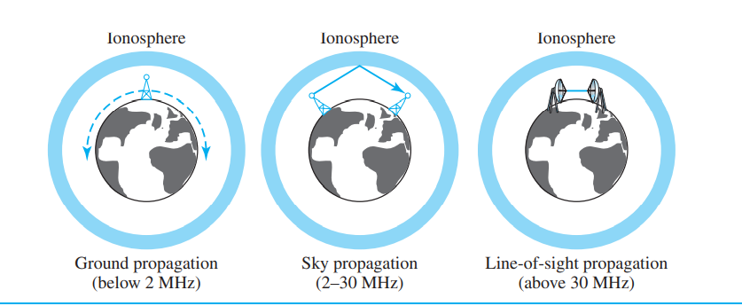

Slide 35
In-ground propagation, radio waves travel through the lowest portion of the atmosphere, hugging the earth. These low-frequency signals emanate in all directions from the transmitting antenna and follow the curvature of the planet. Distance depends on the amount of power in the signal: The greater the power, the greater the distance.
In sky propagation, higher-frequency radio waves radiate upward into the ionosphere (the layer of the atmosphere where particles exist as ions) where they are reflected back to earth. This type of transmission allows for greater distances with lower output power.
In line-of-sight propagation, very high-frequency signals are transmitted in straight lines directly from antenna to antenna. Antennas must be directional, facing each other, and either tall enough or close enough together not to be affected by the curvature of the earth. Line-of sight propagation is tricky because radio transmissions cannot be completely focused.

Slide 36
wireless transmission into three broad groups:
radio waves, microwaves, and infrared waves
Electromagnetic waves ranging in frequencies between 3 kHz and 1 GHz are normally called radio waves; waves ranging in frequencies between 1 and 300 GHz are called microwaves

Slide 37
Radio waves, for the most part, are omnidirectional. When an antenna transmits radio waves, they are propagated in all directions.
This means that the sending and receiving antennas do not have to be aligned. A sending antenna sends waves that can be received by any receiving antenna. The omnidirectional property has a disadvantage, too.
The radio waves transmitted by one antenna are susceptible to interference by another antenna that may send signals using the same frequency or band.

Slide 38
Radio waves, particularly those waves that propagate in the sky mode, can travel long distances.
This makes radio waves a good candidate for long-distance broadcasting such as AM radio. Radio waves, particularly those of low and medium frequencies, can penetrate walls.
This characteristic can be both an advantage and a disadvantage. It is an advantage because, for example, an AM radio can receive signals inside a building. It is a disadvantage because we cannot isolate a communication to just inside or outside a building.
The radio wave band is relatively narrow, just under 1 GHz, compared to the microwave band. When this band is divided into subbands, the subbands are also narrow, leading to a low data rate for digital communications.

Slide 39
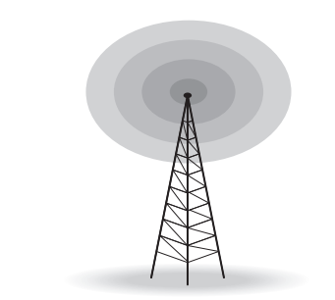
Omnidirectional Antenna
Omnidirectional Antenna Radio waves use omnidirectional antennas that send out signals in all directions. Based on the wavelength, strength, and purpose of transmission, there are different types of antennas.

Slide 40
Microwaves Electromagnetic waves having frequencies between 1 and 300 GHz are called microwaves.
Microwaves are unidirectional. When an antenna transmits microwaves, they can be narrowly focused.
This means that the sending and receiving antennas need to be aligned. The unidirectional property has an obvious advantage. A pair of antennas can be aligned without interfering with another pair of aligned antennas.

Slide 41
The following describes some characteristics of microwave propagation:
❑ Microwave propagation is line-of-sight. Since the towers with the mounted antennas need to be in direct sight of each other, towers that are far apart needed to be very tall.
The curvature of the earth as well as other blocking obstacles do not allow two short towers to communicate by using microwaves. Repeaters are often needed for long-distance communication.
❑ Very high-frequency microwaves cannot penetrate walls. This characteristic can be a disadvantage if receivers are inside buildings.
❑ The microwave band is relatively wide, almost 299 GHz. Therefore wider subbands can be assigned, and a high data rate is possible.
❑ Use of certain portions of the band requires permission from authorities.

Slide 42
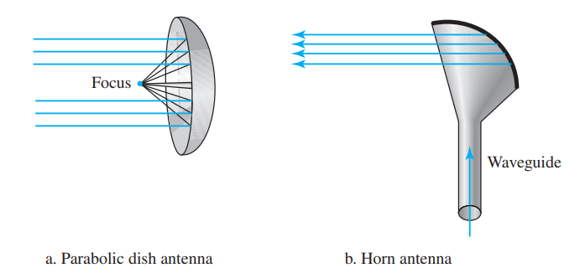
Unidirectional Antenna
Microwaves need unidirectional antennas that send out signals in one direction.
Two types of antennas are used for microwave communications: the parabolic dish and the horn

Slide 43
A parabolic dish antenna is based on the geometry of a parabola: Every line parallel to the line of symmetry (line of sight) reflects off the curve at angles such that all the lines intersect in a common point called the focus.
The parabolic dish works as a funnel, catching a wide range of waves and directing them to a common point.
In this way, more of the signal is recovered than would be possible with a single-point receiver. Outgoing transmissions are broadcast through a horn aimed at the dish.
The microwaves hit the dish and are deflected outward in a reversal of the receipt path.

Slide 44
A horn antenna looks like a gigantic scoop. Outgoing transmissions are broadcast up a stem (resembling a handle) and deflected outward in a series of narrow parallel beams by the curved head.
Received transmissions are collected by the scooped shape of the horn, in a manner similar to the parabolic dish, and are deflected down into the stem.

Slide 45
Microwaves, due to their unidirectional properties, are very useful when unicast (one-on-one) communication is needed between the sender and the receiver. They are used in cellular phones (satellite networks and wireless LANs

Slide 46
Infrared Infrared waves, with frequencies from 300 GHz to 400 THz (wavelengths from 1 mm to 770 nm), can be used for short-range communication.
Infrared waves, having high frequencies, cannot penetrate walls. This advantageous characteristic prevents interference between one system and another; a short-range communication system in one room cannot be affected by another system in the next room.

